Slide 1
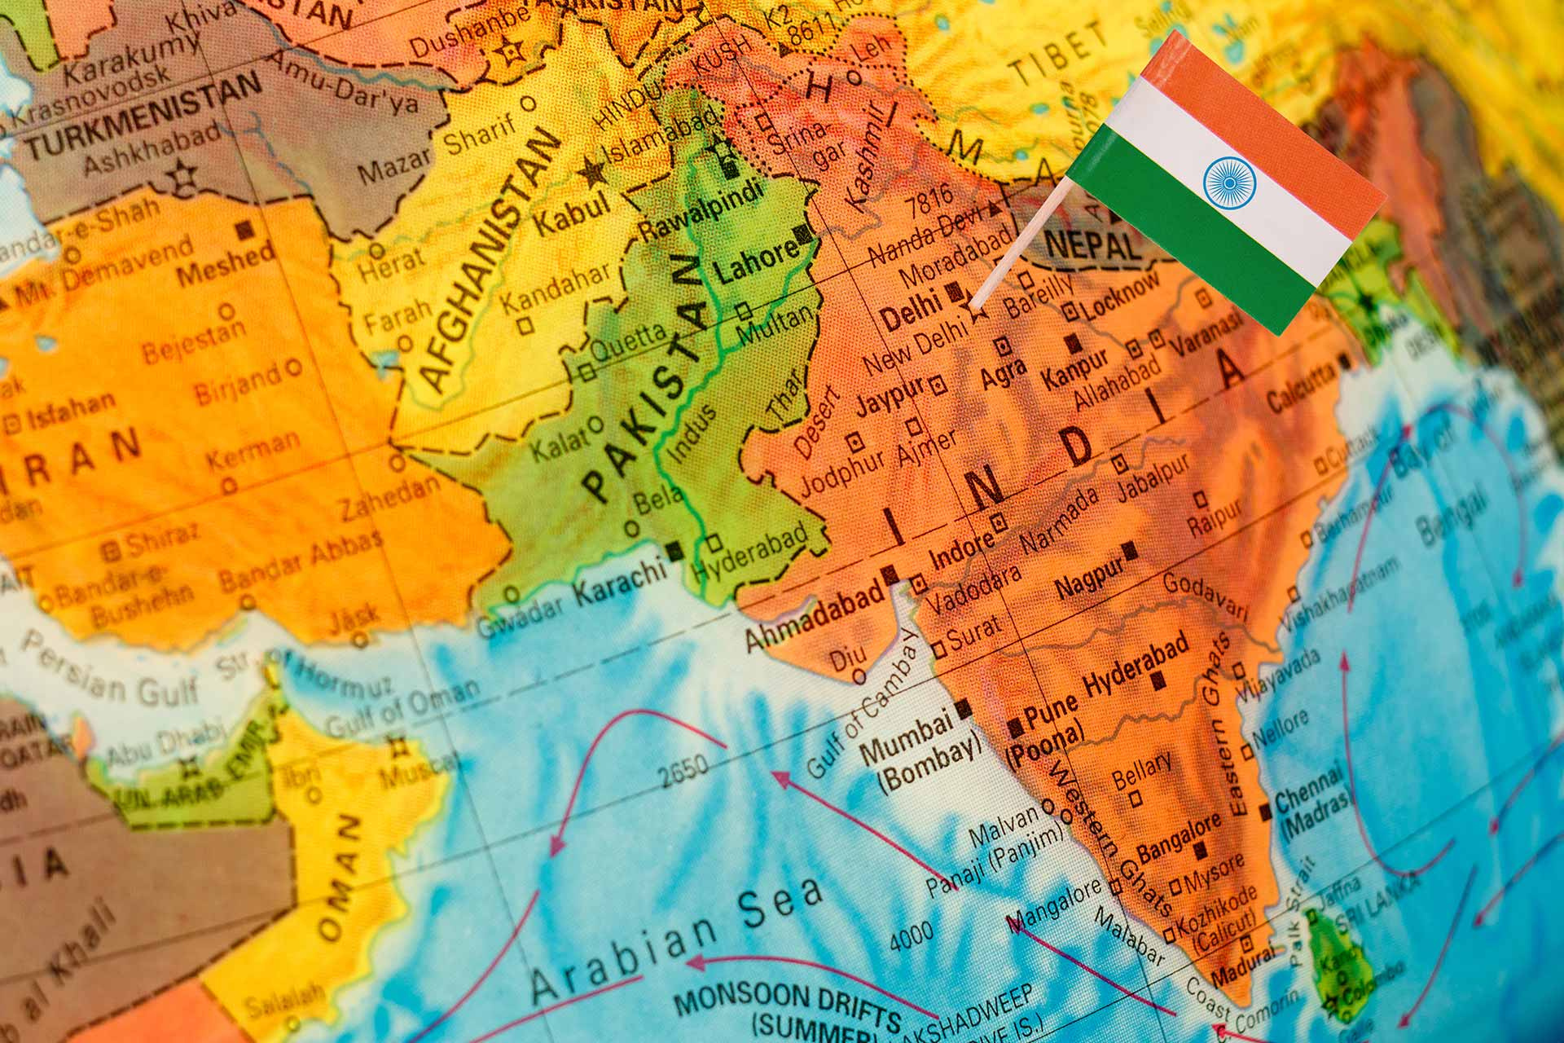
Erasmus University Rotterdam
RSBY Reform in India
(1)
Did it make a difference?
Aida van Riel, Chiara, Elizaveta, Livio, Maria Luisa, Nilda ​

Slide 2
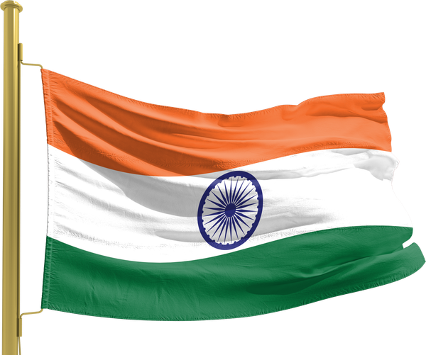



India
Over a billion people
Healthcare system under pressure
Dual burden
Weak primary care system
Need for a reform
RSBY

Slide 3


How does the RSBY work?
Who is the scheme for?
Enrollment
  Below the poverty line
    50% error rates
  Over and under coverage
    Problematic coverage capped at 5 family members
  Physically at camp
  Nationally 57% ⟶
  No active outreach
    But handing out leaflets significantly raises enrollment
(2)
3% and 90%
(3)
(4)

Slide 4


Incentives
Demand side
Supply side
  No payment at the door
  Coverage 725+ procedures (including pre-existing conditions)
  1000 rupees for transport costs
  Registration fee (30 cents)
  ONLY inpatient care
  Insurers
    Competitive bidding ⟶ lowest price, but quality?
    Enrolling many households
  Hospitals
    Slow reimbursements
    Refusing patients, medicine/tests outside hospital
(5)
Expected = 250 million ⟶ Reality = 5.8 Million

Slide 5


Data & Methods
  Three CES waves (1999-2000, 2004-2005, 2011-2012) and district-level data on household RSBY enrollment​
  Difference-in-Differences (DID) combined with Propensity Score Matching ​
  Parallel Trends Assumption holds
  SUTVA assumes no interference across districts; not directly tested​
  Intention-To-Treat Effect (ITT)
Treatment group
Poor households in districts that adopted RSBY ≤ March 2010 and between April 2010-March 2012
Control group
Poor households in districts that had not implemented RSBY by March 2012​

Slide 6


Expected impact of RSBY reform on OOP ​
Lower OOP
Lower OOP
  If inpatient and outpatient care are substitutes ​
  Postponement of care
Higher OOP
Lower OOP
  If inpatient and outpatient care are complements​
  Increase in utilization of medical services

Slide 7


Results: Causal impact on OOP ​
Inpatient OOP
Outpatient OOP
Total OOP
No evidence of reduced financial burden
Odds of incurring outpatient OOP increased by ~23% (early-treated)​
Odds of incurring any OOP spending increased by ~30% (early-treated)
Some evidence of an ~11% reduction in OOP levels
(later-treated)​

Slide 8


Policy implications
Boost enrollment & awareness
  Address sub-50% enrollment rates
  Targeted outreach and better education on eligibility and benefits
Awareness of eligibility and benefits
  Shift policy priority
  Raw enrollment numbers ⟶ educating households on the benefits of RSBY
Expand benefit scope
  Include outpatient care (chronic illnesses)
  Raise the INR 30,000 annual cap to cover catastrophic expenses
Strengthen primary healthcare
  Complement insurance schemes with a robust primary care system to ensure a comprehensive continuation of care

Slide 9


Limitations of the study
  No available data on household enrollment (only district-level)​
    The study measures the "Intention-to-Treat" (ITT) rather than the "Average Treatment Effect" (ATT)​
  Inconsistent recall periods and potential recall bias​
  Assumption that the BPL corresponds to the bottom 2 quintiles for household expenditure​
  Does not consider coping strategies and how they may affect OOP spending​
  Potential for adding further outcomes​
    E.g. health outcomes; utilization ​
  Unknown mechanisms behind RSBY lack of effect
30 days
1 year
Outpatient care
Inpatient care

Slide 10
Limitations of the reform
  Extend coverage to outpatient care and drugs/diagnostics​
  Raise coverage limit​
    PM-JAY increased the coverage limit from 30,000 to 500,000 INR in 2018​
  Remove the cap on the number of people per household​
  Replace BPL list with other means-testing to really capture the poorest​
  Fast reimbursement guarantee for hospitals​
  Reduce negative incentives on the supply side​
  Improve enrollment campaign​
    Active enrollment​
    Continuous enrollment
  Promote the insurance and increase awareness among the eligible demographic
(6)
(6)
(7)

Slide 11

Conclusion
RSBY
  promised financial protection to 150 million people
  inaccurate eligibility lists
  excluded 80% of healthcare spending
  had incentives
The paper
  confirms it didn't work
  no household-level data ⟶ what's the effect on actual users?
  recall period mismatch
  WHY?
Knowing a policy failed is only the beginning. Understanding why is what you actually need to build something better.

Slide 12
References
  Karan, A., Yip, W., & Mahal, A. (2017). Extending health insurance to the poor in India: An impact evaluation of Rashtriya Swasthya Bima Yojana on out of pocket spending for healthcare. Social Science & Medicine, 181, 83–92. https://doi.org/10.1016/j.socscimed.2017.03.053
  Government of India, Ministry of Rural Development. Report of the Expert Group to Advise the Ministry of Rural Development on the Methodology for Conducting the Below Poverty Line Census. New Delhi: Ministry of Rural Development; 2009.
  Dubey A, Palmer-Jones R, Sen K. Fertility and the household's economic status: A natural experiment using Indian micro data. J Dev Stud. 2006;42(1):110–138
  Das J, Leino J. Evaluating the RSBY: Lessons from an experimental information campaign. Econ Polit Wkly. 2011;46(32):85–93.
  Rajasekhar D, Berg E, Ghatak M, Manjula R, Roy S. Implementing health insurance: The rollout of Rashtriya Swasthya Bima Yojana in Karnataka. Econ Polit Wkly. 2011;46(20):56–63.
  Selvaraj S, Karan AK. Deepening health insecurity in India: Evidence from national sample surveys since 1980s. Econ Polit Wkly. 2009;44(40):55–60
  National Health Authority, Government of India. About PM-JAY [Internet]. New Delhi: National Health Authority; 2018 [cited 2026 Mar 7]. Available from: https://nha.gov.in/PM-JAY.

